Slide 1
NOAA 2018 Hurricane Season Outlooks
Dr. Gerry Bell
Lead Seasonal Forecaster
Climate Prediction Center NOAA/ NWS/ NCEP
Collaboration With
National Hurricane Center/ NOAA/NWS/NCEP
Hurricane Research Division/ NOAA/OAR/AOML
Central Pacific Hurricane Center NOAA/NWS
Presented to
Subcommittee on Disaster Reduction (SDR)
June 7, 2018
Atlantic Outlook: http://www.cpc.ncep.noaa.gov/products/outlooks/hurricane.shtml
Press Release: http://www.noaa.gov/media-release
1

Slide 2
Outline
Prediction regions
2018 Outlooks for the Atlantic, eastern Pacific, and central Pacific
Science behind the outlooks
Multi-decadal cycles in hurricane season strength and hurricane landfalls
Summary
2

Slide 3
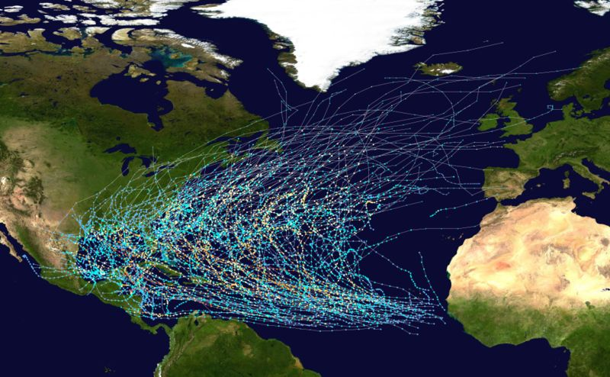
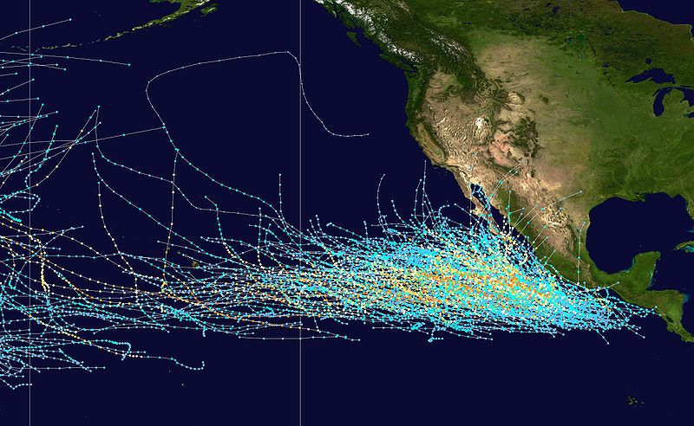
NOAA’s Hurricane Outlook Regions
Atlantic Basin
Storm Tracks 1980-2005
Central and Eastern North Pacific
Storm Tracks 1980-2005
Central Pacific
Eastern Pacific
Main Development Region (MDR)
140ºW
Figure Courtesy of Wikipedia
NOAA issues seasonal hurricane outlooks for the Atlantic basin, the central North Pacific, and the eastern North Pacific.
3

Slide 4
How and When the Outlooks are Issued
Outlooks issued in late May
  Press release, and technical write-up, social media
  Atlantic outlook has national press conference
  Central Pacific outlook has press conference in Hawaii
  Atlantic outlook is updated early August-
    Coincides with peak of season (August-October).
4

Slide 5
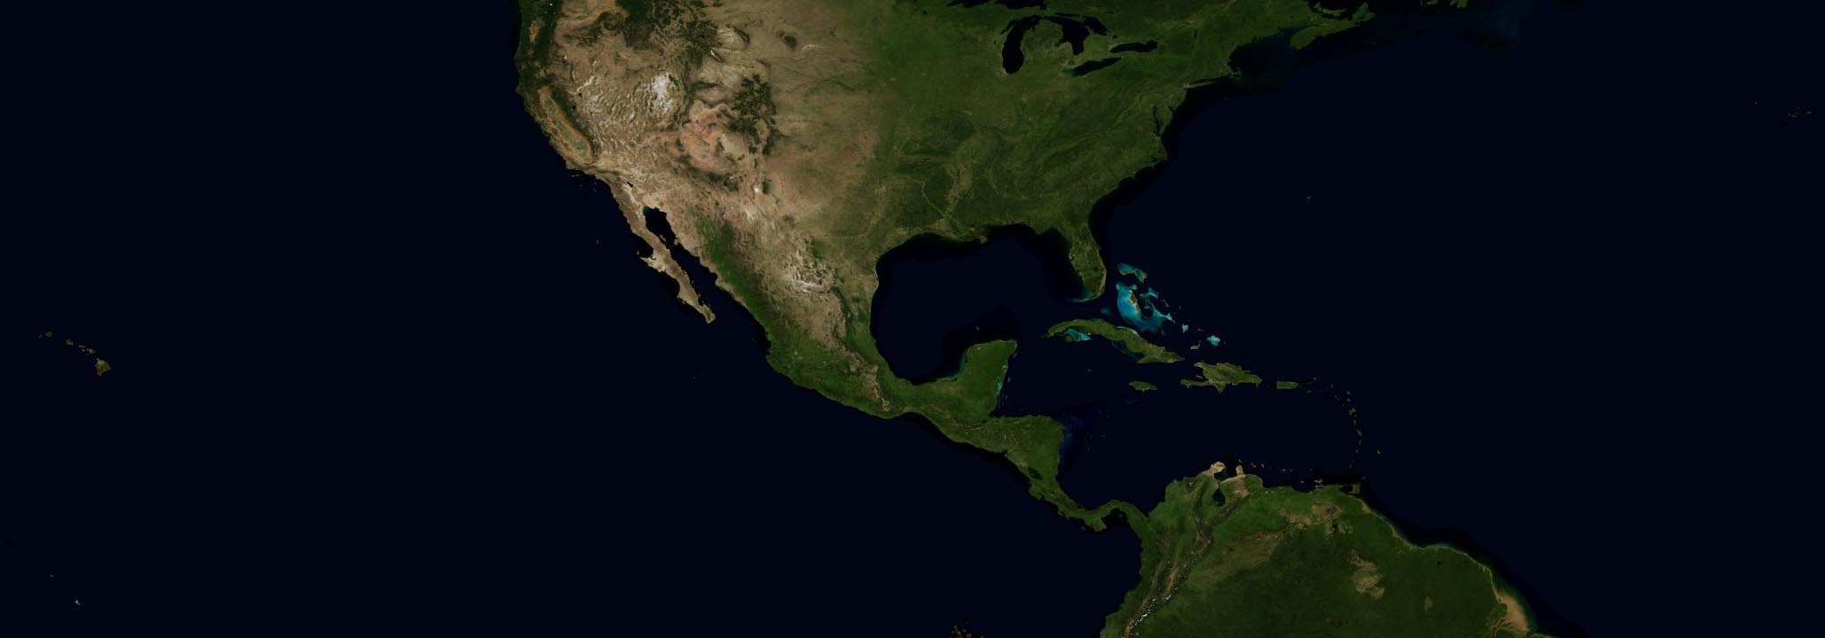
NOAA’s 2018 Hurricane Season Outlooks Issued May 23-24
  Outlooks are for the overall seasonal activity. They are not a hurricane landfall prediction and do not imply levels of activity for any particular location.
A near- or above-normal season is predicted for each region: A lot of activity.
Central Pacific
Near- or Above-Normal (80%)
3-6 Tropical Cyclones
Average is 4-5 TCs
Atlantic
Near- or Above-Normal (75%)
10-16 Named Storms
5-9 Hurricanes
1-4 Major Hurricanes
Averages are 12 NS, 6 H, 3 MH
Eastern Pacific
Near- or Above-Normal (80%)
14-20 Named Storms
7-12 Hurricanes
3-7 Major Hurricanes
Averages are 15 NS, 8 H, 4 MH
We do not expect the 2018 Atlantic hurricane season to be as active as last year, which produced 17 named storms, 10 hurricanes and 6 major hurricanes.
Named storms (39+ mph) Hurricanes (74+ mph) Major Hurricanes (Cat. 3-4-5, 111+mph).
5

Slide 6
Science Behind the Outlooks
6

Slide 7
NOAA’s Approach to Making Hurricane Season Outlooks
Global climate patterns strongly influence hurricane conditions for months/ seasons/ decades at a time.
By predicting key climate patterns, we can often predict the hurricane-influencing conditions, and therefore predict the strength of the upcoming hurricane season.
This is how we do it
Extensive monitoring and analysis
Global ocean and atmosphere data: Allows us to monitor and study global weather and climate patterns on a daily basis.
Research: Over 30+ years research into hurricanes and global climate patterns
Suite of statistical prediction tools and climate model predictions (developed in last 10 years)
7

Slide 8
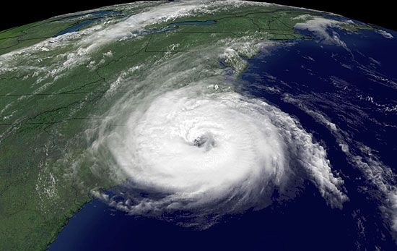
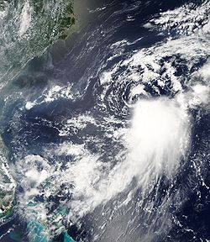
Hurricanes Require Weak Vertical Wind Shear
Vertical wind shear refers to the change in wind speed and direction going up through the atmosphere.
Hurricanes need weak shear- little change in winds.
Hurricanes destroyed by strong shear-large change in winds
40,000 ft.
40,000 ft.
Upper-Level Winds
Upper-Level Winds
Looking sideways through storm clouds
EYE
Eye Wall
Eye Wall
Ocean
Lower-Level Winds
Ocean
Lower-Level Winds
Strong Hurricane
Strongly Sheared Storm
Lower clouds and circulation
Looking down on storm clouds
Upper clouds
8

Slide 9
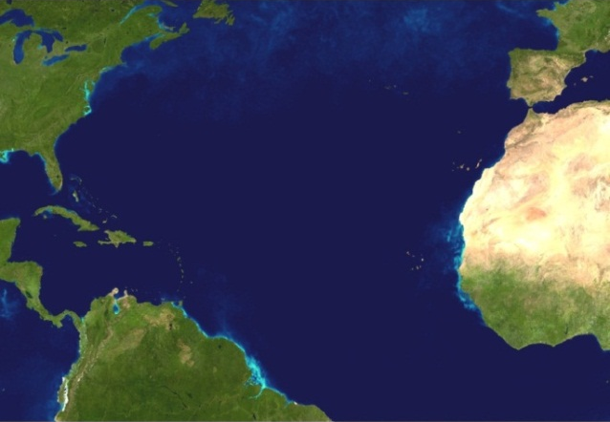
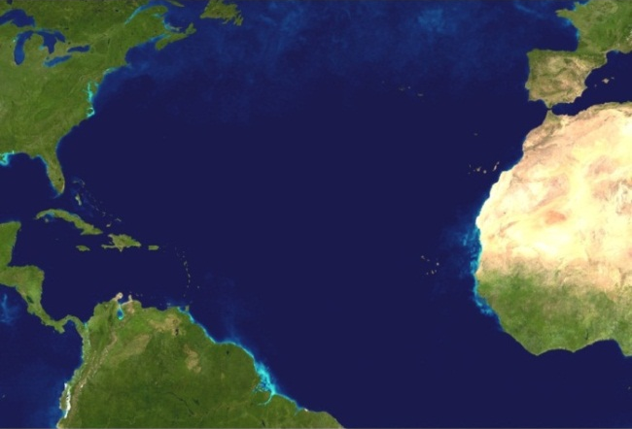
These Climate Patterns Strongly Influence Atlantic Hurricane Season
El Niño/ La Niña: Year-to-year changes in Atlantic hurricanes
Atlantic Multi-Decadal Oscillation (AMO): Multi-decadal cycles in Atlantic hurricanes
El Niño: Fewer Hurricanes
Climate Pattern for High-Activity Era
Warmer Ocean
Stronger Shear
Warm Phase of AMO
Warm, Wet
Warmer Ocean
Weaker Shear
Stronger, wetter
West African Monsoon
Main Development Region
La Niña: More Hurricanes
Climate Pattern for Low-Activity Era
Weaker Shear
Cool, Dry
Cooler Ocean
Cool Phase of AMO
Cooler Ocean
Stronger Shear
Weaker, drier
West African Monsoon
Predicting these climate patterns and their interaction is the basis for making NOAA’s seasonal hurricane outlook.
Main Development Region
9

Slide 10
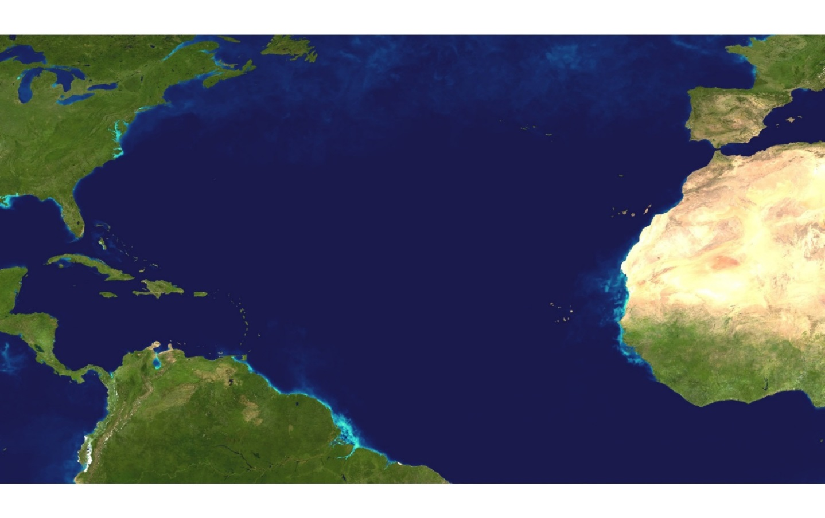
Expected Atlantic Conditions for 2018
The 2018 Atlantic outlook reflects predictions for:
ENSO-neutral (No El Niño or La Niña) or weak El Niño,
Near-average ocean temperatures in the Main Development Region,
Near- average or weaker wind shear associated with ongoing warm phase of AMO and high-activity era.
Expect ENSO-neutral, possible El Niño
Near-average ocean temperatures (cooler than 2017)
Near-average or weaker vertical wind shear (stronger than 2017)
Atlantic Main Development Region
10

Slide 11
Multi-Decadal Cycles in Hurricane Season Strength and Hurricane Landfalls
11

Slide 12
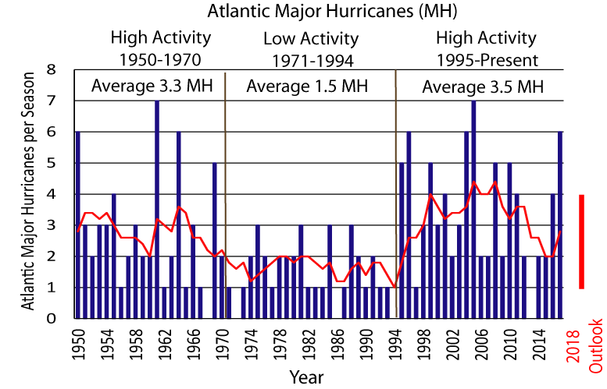
25-40 Year Cycles in Atlantic Hurricanes
Time series of Atlantic major hurricanes since 1950
5-yr Running Mean
1981-2010 Average
Because of the Atlantic Multi-Decadal Oscillation, hurricane seasons have 25-40 cycles.
We are still likely in a high-activity era for Atlantic hurricanes that began in 1995.
High-activity era’s feature more, stronger, and longer-lived storms:
Major hurricanes: more than double
Hurricanes: 30%-50% increase
Named storms: 20%-40% increase
12

Slide 13
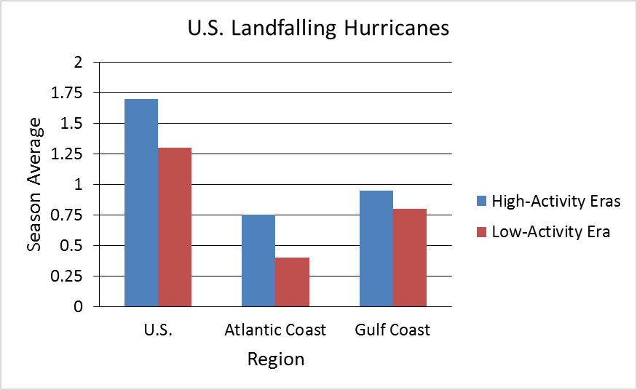
U.S. Hurricane Landfalls During High- and Low-Activity Eras
37% Increase
10% Increase
85% Increase
During high activity eras, both the U.S. Atlantic and Gulf coasts experience more landfalling hurricanes.
Largest increase in hurricane landfalls is seen along the Atlantic coast.
U.S. sees almost a doubling of seasons with multiple landfalling hurricanes.
13

Slide 14
Coastal Population Growth
High
Activity Era
High
Activity Era
Low
Activity Era
Low
Activity Era
Variable
Exponential growth along the Atlantic and Gulf Coasts has put far more people and property ($$$) in harm’s way. 80+ million people are considered Atlantic or Gulf Coast residents that can be impacted by a tropical storm or hurricane.
14

Slide 15
Summary
We expect near-normal or above-normal hurricane seasons this year in all three hurricane regions (Atlantic, eastern Pacific, and central Pacific).
This is a lot of activity.
Last year, major hurricanes Harvey, Irma, and Maria caused over $265 Billion in damage.
Hurricanes NOT just a coastal event; can impact millions in many different ways.
Prepare for every hurricane season regardless of the outlook.
High-activity era for Atlantic hurricanes began in 1995, following decades of exponential growth in coastal regions. More hurricanes and more people in harm’s way.
Emergency planning/ execution is far more challenging, demands much longer forecast lead times.
15

Slide 16
Supplemental Materials
S1

Slide 17
Preparedness
www.ready.gov
www.nhc.noaa.gov
Tropical storms and hurricanes can cause tremendous damage, flooding, death.
Preparedness situations can differ: Location, children, pets, finances, property, transportation, structure of home, etc.
Tropical storms and hurricanes produce many different kinds of storm conditions.
Your preparedness plans must reflect both your personal situation and the storm conditions you might expect.
Immediate coastal impacts- Storm surge, evacuation, complete destruction
Non-coastal impacts
Inland flooding
Strong winds/ downed trees and power lines
Tornadoes
S2

Slide 18
Landfalling Major Hurricanes Last Year (2017)
Major hurricanes Harvey, Irma, and Maria cause over $265 Billion in damage.
S3

Slide 19
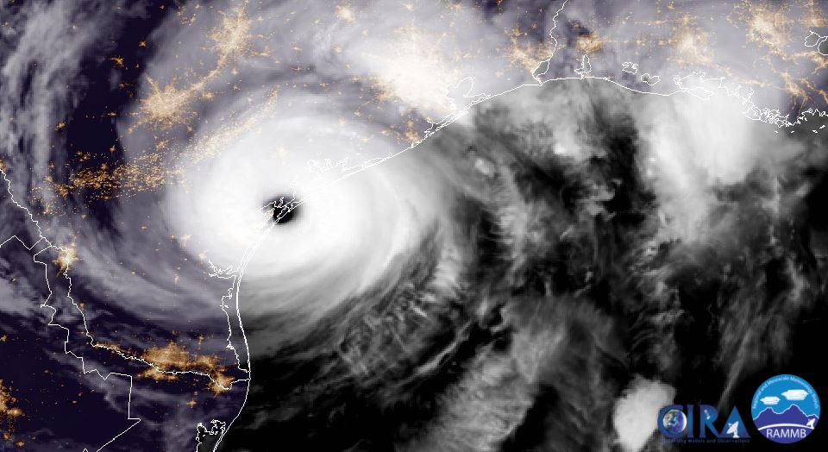
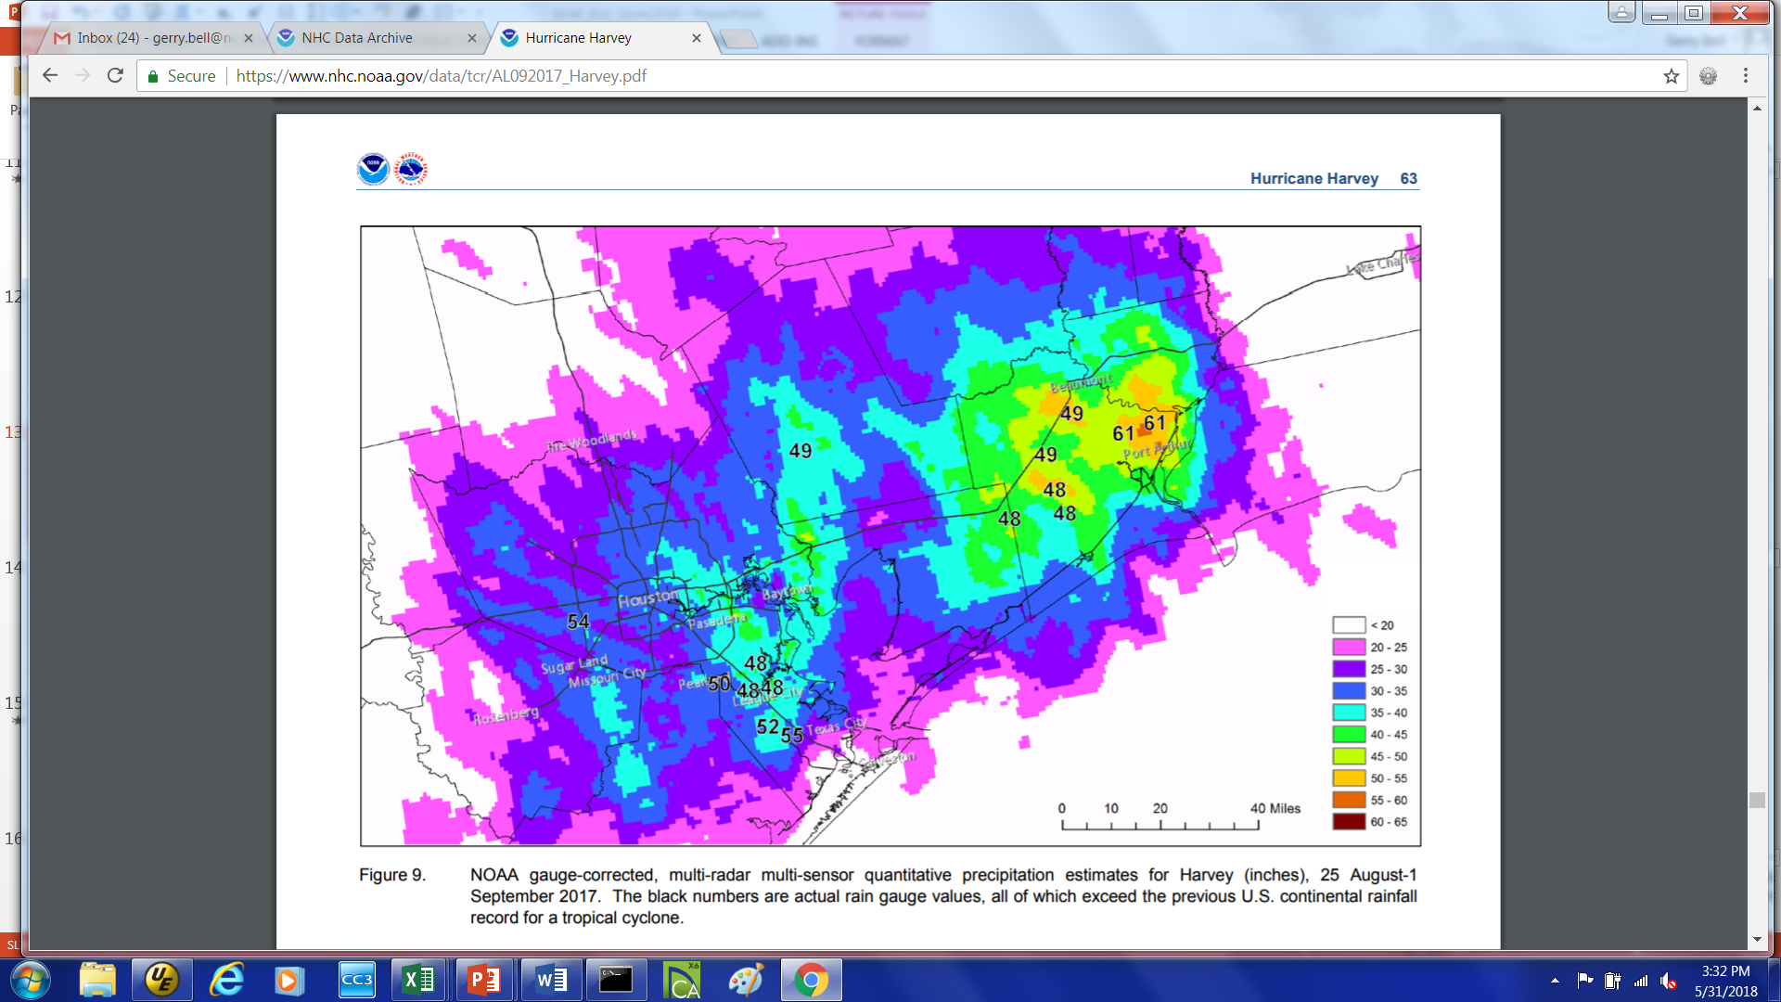
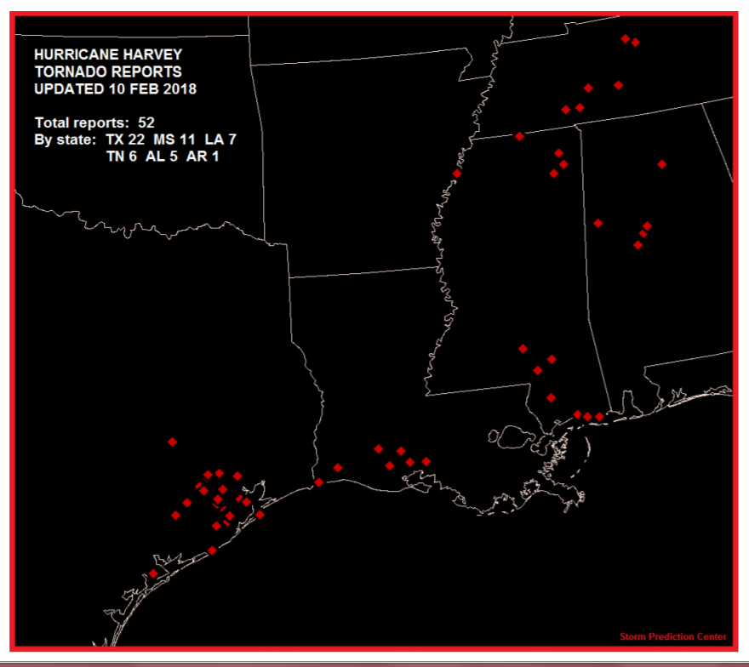
Major Hurricane Landfalls Last Year
Major Hurricane Harvey: First MH to strike the U.S. since 2005
Intense Rain Bands extend 100’s of miles from Harvey
Eye
Eye wall (115-130 mph winds)
Harvey Rainfall Totals (Inches)
< 20
20-25
25-30
30-35
35-40
40-45
45-50
50-55
55-60
60-65
Harvey Tornadoes (52)
Hurricanes produce storm surge, devastating winds, flooding, mud-slides, tornadoes
S4

Slide 20
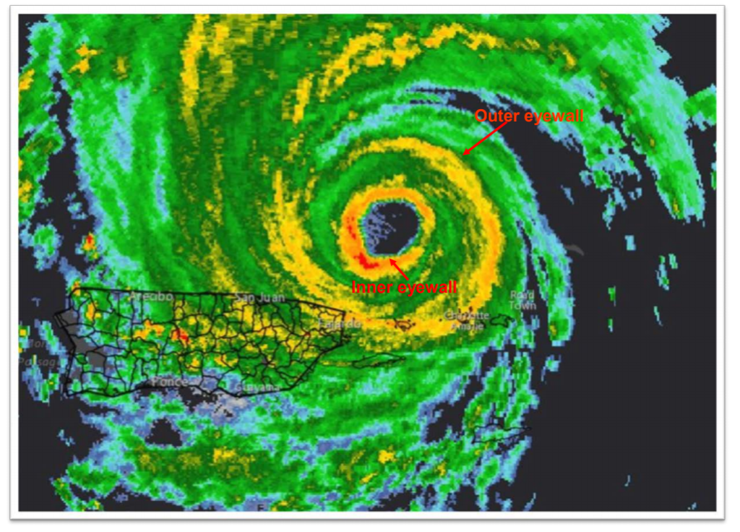
Major Hurricane Irma: Last Year:
Cat. 5 Storm with 155+ mph winds
Double eye-wall north of Puerto Rico
Radar Image
Eye
Inner eye-wall
Outer eye-wall
Puerto Rico
Yellow/ orange/ Red shading indicates heavy rainfall
Eye wall diameter is as big as Puerto Rico
Cities, states, entire islands are tiny compared to a big hurricane
S5

Slide 21
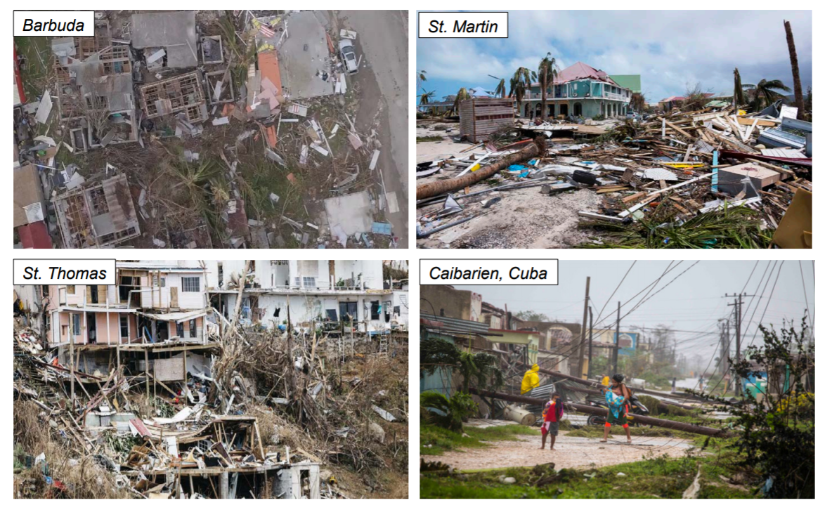
Major Hurricane Irma: Last Year- Cat. 5 with 155+ mph winds
S6

Slide 22
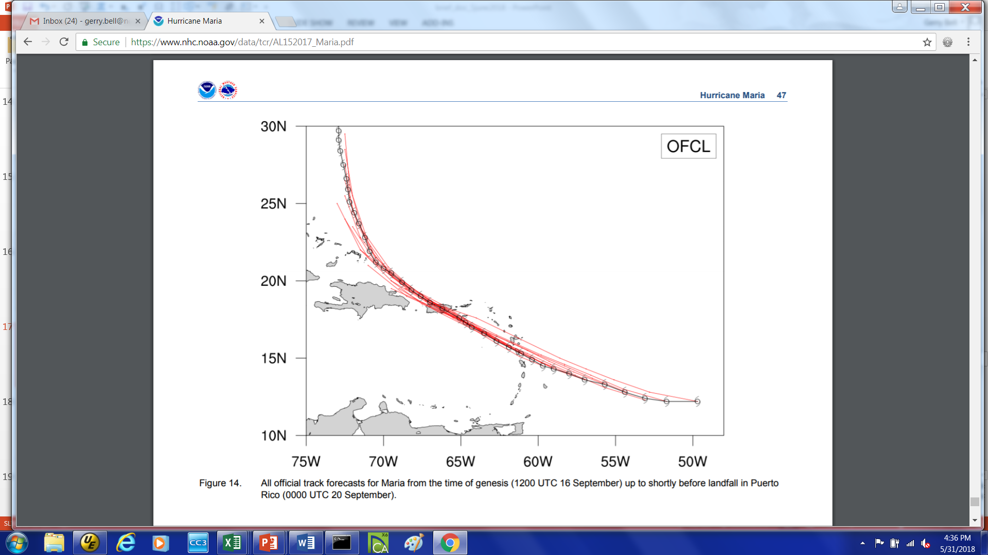
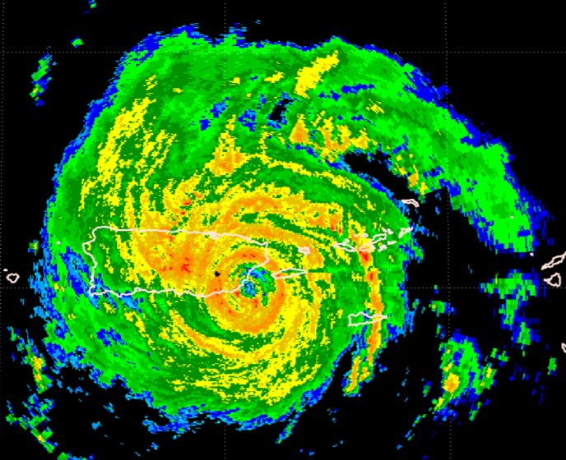
Major Hurricane Maria: Last Year: Cat. 5 with 155+ mph winds
Maria’s Track (Black) and Forecasted Tracks (Red)
Maria Making Landfall in Puerto Rico Last Radar Image before Radar was destroyed
Puerto Rico: $90+ billion in damage
Puerto Rico
Intense Rain Bands
Dominica
Puerto
Rico
Maria moved directly across Dominica and Puerto Rico with 155+ mph winds.
Inner eye-wall
Outer eye-wall
Yellow/ orange shading indicates heavy rainfall
Excellent forecasts for Maria (Red lines) from the time it formed.
Predictions undoubtedly helped save countless lives, especially coming on the heels of MH Irma just a few weeks earlier.
S7

